Slide 1
Calculations from Chemical Equations
Stoichiometry
Mole-Mole Calculations
Mole-Mass Calculations
Mass-Mass Calculations

Slide 2
What is stoichiometry?
Stoichiometry is the quantitative study of reactants and products in a chemical reaction.

Slide 3
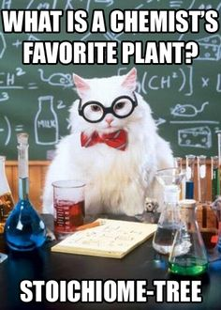
What is stoichiometry?

Slide 4
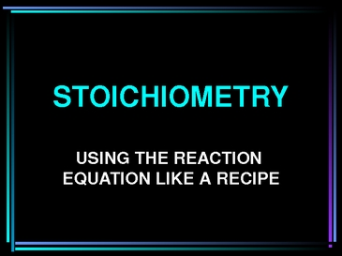

What You Should Expect
Given : Amount of reactants
Question: how much of products can be formed.
Example
2 A + 2B → 3C
Given 20.0 grams of A and sufficient B, how many grams of C can be produced?

Slide 5
What do you need?
You will need to use
molar ratios,
molar masses,
balancing and interpreting equations, and
conversions between grams and moles.
Note: This type of problem is often called "mass-mass."

Slide 6





Moleville
Moletown
Mole Ratio
Bridge
Molar Mass
Railroad
Molar Mass
Railroad
Mass Junction
Mass Valley

Slide 7
Stoichiometry
Stoichiometry: calculations based on a balanced chemical equation
Moles of “A”
Mole Ratio
Moles of “B”
Molar Mass
Molar Mass
Grams of “A”
Grams of “B”
Mole ratio: ratio of coefficients of any two substances in a balanced chemical equation

Slide 8
Mole Ratios
A mole ratio converts moles of one compound in a balanced chemical equation into moles of another compound.

Slide 9
The Goal
The goal of stoichiometry is to perform conversions (changing between units) by cancelling out units until you end up with the units you want (the answer).

Slide 10
Example
Reaction between magnesium and oxygen to form magnesium oxide. ( fireworks)
2 Mg(s) + O₂(g) 2 MgO(s)
Mole Ratios:
2 : 1 : 2

Slide 11
Mole-Mole Calculations
How many moles of water can be obtained from the reaction of 4 moles of O₂?
2 H₂ (g) + 1 O₂ (g) → 2 H₂O (g)
4 mol O₂
1
2 mol H₂O
1 mol O₂
x
= 8 mol H₂O
Mole Ratio

Slide 12
How many moles of NH₃ can be obtained from the reaction of 8 moles of H₂?
__ H₂ (g) + __ N₂ (g) → __ NH₃ (g)
3 1 2
8 mol H₂
1
2 mol NH₃
3 mol H₂
= 5.33 mol NH₃
x
Mole Ratio

Slide 13
Mole-Mass Calculations
2 Al (s) + 6 HCl (aq) → 2 AlCl₃ (aq) + 3 H₂ (g)
What mass of hydrogen gas can be produced by reacting 6 moles of aluminum with HCl?
6 mol Al
1
3 mol H₂
2 mol Al
2.0 g H₂
1 mol H₂
x
x
= 18 g H₂
Mole Ratio
Molar Mass

Slide 14
2 Al (s) + 6 HCl (aq) → 2 AlCl₃ (aq) + 3 H₂ (g)
What mass of HCl is needed to react with 6 moles of aluminum?
6 mol Al
1
6 mol HCl
2 mol Al
36.0 g HCl
1 mol HCl
x
x
= 648 g HCl
Mole Ratio
Molar Mass

Slide 15
Mass-Mass Calculations
Sn(s) + 2 HF (g) → SnF₂ (s) + H₂ (g)
How many grams of SnF₂ can be produced from the reaction of 30.00 g of HF with Sn?
30.00 g HF
1
1 mole HF
20.01 g HF
1 molSnF₂
2 mol HF
156.71 g SnF₂
1 mol SnF₂
x
x
x
= 117.5 g
SnF₂
Molar Mass
Molar Mass
Mole Ratio

Slide 16
Steps Involved in Solving Mass-Mass Stoichiometry Problems
Balance the chemical equation correctly
Using the molar mass of the given substance, convert the mass given to moles.
Construct a molar proportion (two molar ratios set equal to each other)
Using the molar mass of the unknown substance, convert the moles just calculated to mass.

